Slide 1
📘 Story Dataset Analysis
By Nikita Vishwakarma

Slide 2
Table of Contents
Introduction
Dataset Summary
Genre Distribution
Likes and Views by Genre
Age Group Distribution
Likes by Format
Price by Format
Top Stories
Conclusion

Slide 3
📚 Introduction
This project analyzes a dataset of 1,000,000 fictional stories.
The goal: explore how genre, format, age group, pricing, and user engagement influence popularity.

Slide 4
📦 Dataset Summary
Records:- 1,000,000 stories.
Fields:- Genre, Country, Format, AgeGroups, Status, Language, Pages, Price, Likes, Views, Awards, Author.
No missing values
Unique Genres: 6 | Countries: 5 | Formats: 4 | Age Groups: 3

Slide 5
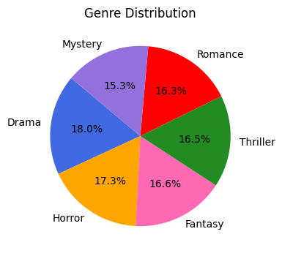
📊 Genre Distribution
Insight:- Drama and Horror dominate the dataset.
Observation:- Genres are fairly balanced, with Drama slightly leading.

Slide 6
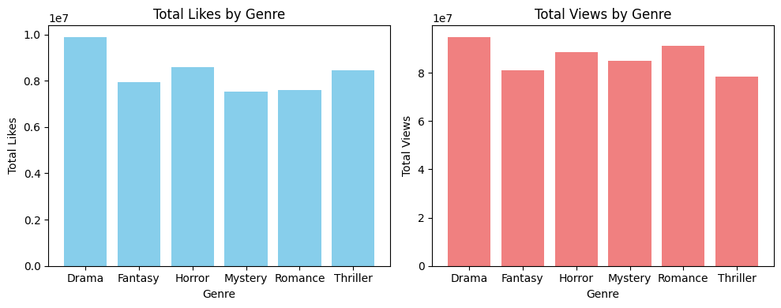
📊 Likes & Views by Genre
Insight: Drama receives the most engagement.
Observation: Drama has the highest likes and views.

Slide 7
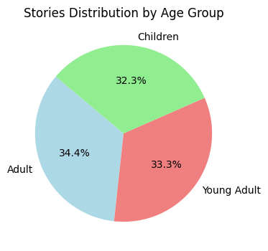
👥 Age Group Distribution
Insight: Adults have the highest number of stories.
Observation: The dataset is slightly skewed toward adults.

Slide 8
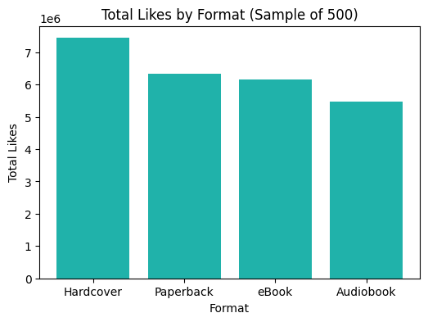
📊 Likes by Format
Insight: Hardcover and Paperback are more liked.
Observation: Physical books drive engagement.

Slide 9
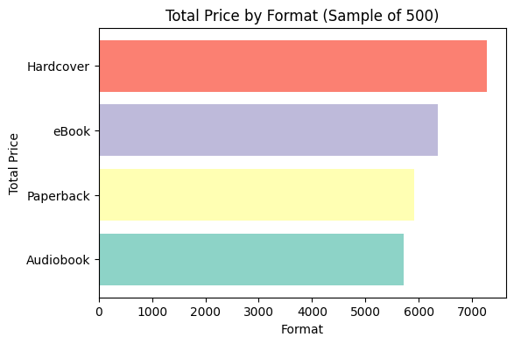
💸 Price by Format
Insight: Hardcover leads in total price.
Observation: Hardcover books generate more revenue.

Slide 10
🏆 Top Stories
Top 10 stories priced ₹100.00
UK Romance stories rank highest in revenue

Slide 11
Conclusion
Drama & Horror are most popular.
Hardcover is top format.
Adults are the primary audience.

Slide 12
Thank You

